Slide 1

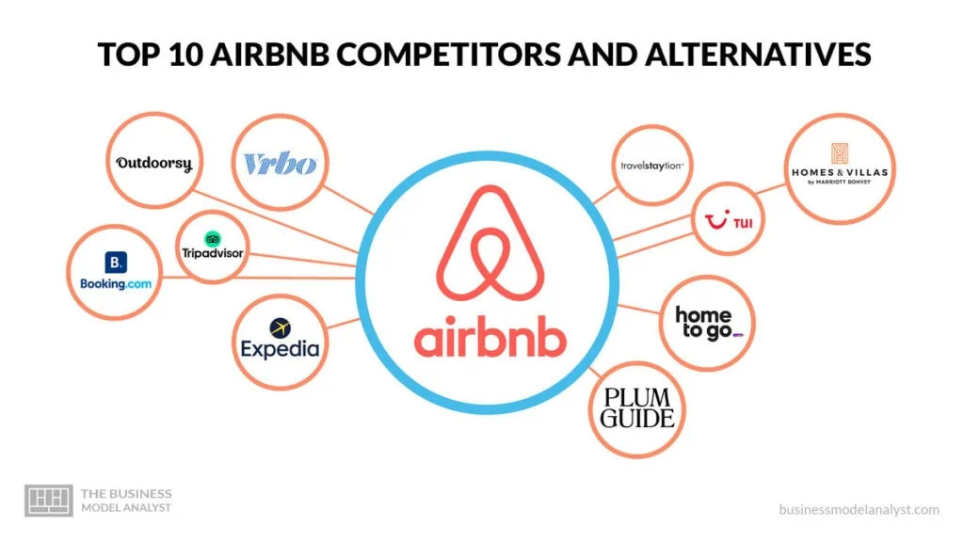
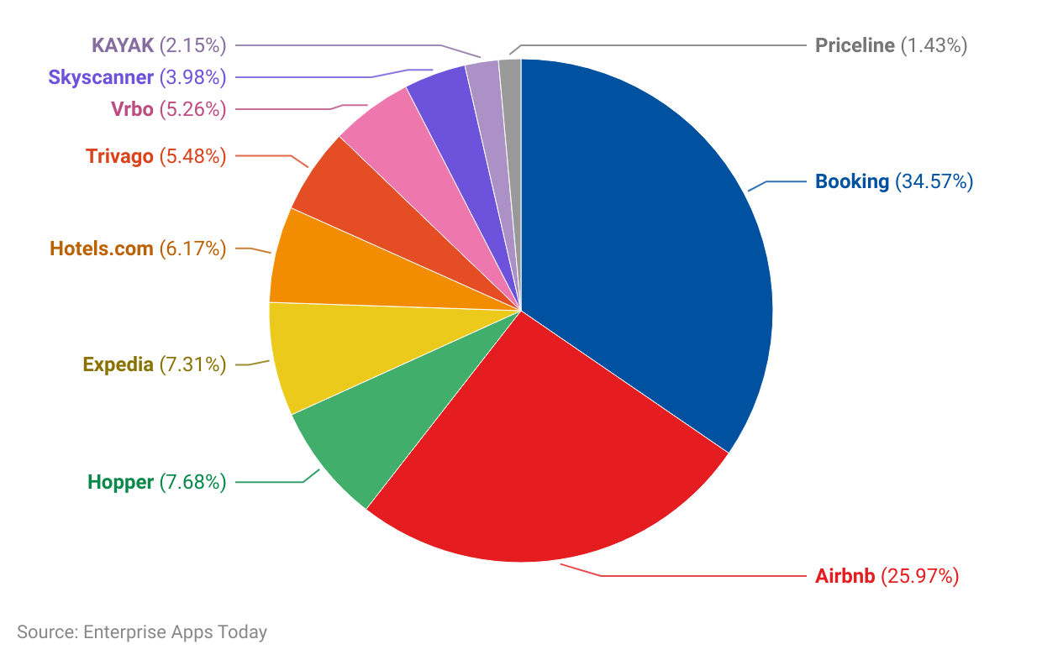


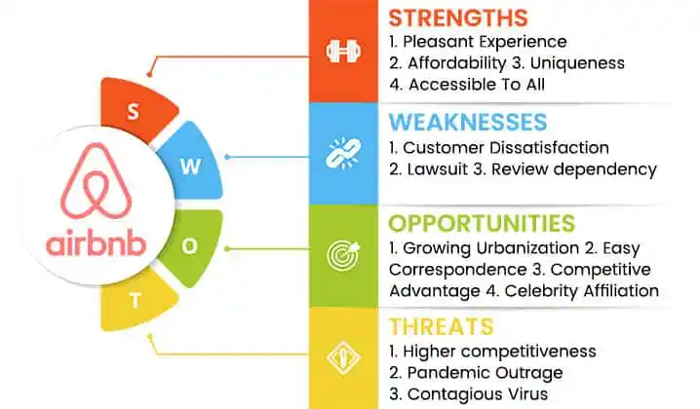



Understanding the Evolving Landscape:Key Challenges in the Global Hospitality Industry
: Case Study
Key Opportunities in the Highly Competitive Market
Expanding into new geographical markets
Diversifying accommodation options and experiences
Partnering with local businesses and tourism organizations
Increasing competition from traditional hotels
Regulatory challenges in different jurisdiction
Ensuring trust and safety for both hosts and guests
Q3 revenue was $3.4 billion, up 18% year-over-year
Emphasizing sustainability and responsible tourism
Collaborating with other travel and hospitality companies
Collaborating with other travel and hospitality companies
Investing in technology and data analytics
Enhancing the digital platform and user experience
Fostering a strong host and guest community
Leveraging Economic Principles and Market Research for Competitive Advantage
Growth Strategies for Airbnb in dynamic Hospitality Industry
Utilizing Pricing Strategies to understand market condition and customer demand
Conducting market research to identify customer preferences
Analyzing economic indicators to predict market trends
Conduct market research to assess competitors' strengths, weaknesses, and market positioning,
Team- MBA ASPIRANT
Manisha Kashyap, manishakashyap85@gmail.com
8709915408

